Slide 1
ND Century Code 25-03.1
Anna Blasey, Kari Bernhardt, and Janel Glass
University of Mary
648 Healthcare Law and Policy
Professor Linda Liebert-Hall
July 14th, 2020
Kari Bernhardt
University of Mary
510 Health Care Across the Population
Dr. Joan Doerner
June 4, 2020

Slide 2
What makes this topic of interest
ND Century Code 25-03.1
Recent evolution of laws in the United States (last 50 years)
Loss of rights
Autonomy, liberty, and due process
Patient forced to get psychiatric care and stay in hospital for a time period
ED nurse that puts patients on psychiatric commitments (holds)
(SAMHSA, 2019)
Notes:
Judge or judicial person orders someone to be confined in a setting providing psychiatric care for a certain period of time.
This is a topic of interest to me because I take care of many patients on holds or psychiatric commitments as an Emergency Department nurse.
Taking someone's rights away and holding them against their will is an interesting subject and poses some ethical dilemmas as well.

Slide 3
Brief Legal History
Ancient Greeks recognized mental illness and recommended civil commitment
Hippocrates
13th Century English Kings
Lunatics vs Idiots
Recent shift in provision of psychiatric care
All states have developed civil commitment laws within the last 50 years
Psychiatric care has shifted from state hospitals to private behavioral health settings
Lessard vs Schmidt 1971
O’conner v. Donaldson 1975 (SAMHSA, 2019)
Notes:
Prior to the mid 20th century all psychiatric care was provided in state hospitals. Now only 2% of psychiatric care is provided in state hospitals.
Prior to the 1960’s civil commitment was less legalistic.
Nearly all states developed civil commitment laws within the last 50 years.
Hippocretes and his followers suggested persons with mental disabilities “be confined in the wholesome atmosphere of a comfortable, sanitary, well-lighted place.” Early Roman law recognized the authority of a guardian to oversee the affairs of individuals with mental disabilities, with suspension of the guardianship during periods of the individual’s lucidity.
“lunatics”—persons with mental illness in today’s parlance—also were provided for by the King, who held the person’s lands during periods of the person’s lunacy and used all of the land’s profits for the maintenance of the person and the person’s household. Any excess was returned to the person “when they came to right mind.”
In 1971, Alberta Lessard was admitted to a facility in Wisconsin on the application of two police officers. The officers presented their allegations to a judge three days later. On the basis of their testimony, the judge continued Ms. Lessard’s stay in the facility for an additional 10 days. Subsequently, a psychiatrist from the facility reported to the court that Ms. Lessard suffered from schizophrenia and should be committed “permanently.” Without Ms. Lessard present, the judge continued her commitment and ordered two additional evaluations. The court assigned Ms. Lessard a guardian ad litem but did not appoint counsel to represent her. Ms. Lessard retained counsel privately, and the court scheduled a hearing five days later. Finding Ms. Lessard to be “mentally ill,” the court continued her commitment for 30 additional days. Subsequently, the facility released Ms. Lessard on outpatient “parole,” but her commitment was extended monthly, every month thereafter. Lessard filed a lawsuit and Wisconsin’s commitment law was found to be unjust.
Dangerousness for commitment
Started discussion about civil commitments

Slide 4
Involuntary Mental Health Commitment Procedures
North Dakota Century Code 25-03.1
•The provisions of this chapter are intended by the legislative assembly to:
•Provide prompt evaluation and treatment of persons with serious mental disorders or a substance use disorder.
•Safeguard individual rights.
•Provide continuity of care for persons with serious mental disorders or a substance use disorder.
•Encourage the full use of all existing agencies, professional personnel, and public funds to prevent duplication of services and unnecessary expenditures.
•Encourage, whenever appropriate, that services be provided within the community.
(North Dakota Century Code 25-03.1)
Notes:
The process for involuntary mental health commitment of an adult can be found in North Dakota Century Code 25-03.1
Purpose of this chapter intended by the legislative assembly is listed and taken directly from the century code
Prompt evaluation and treatment for mental and substance use disorders
Protect individual rights
Continuity of care for these individuals
Full use of services to prevent service duplication and unnecessary expenditures
Utilized services within the community

Slide 5
Definitions Pertaining to ND Law
Individual with a substance use disorder
An individual with an illness or disorder characterized by a maladaptive pattern of usage of alcohol, drugs, or a combination of both resulting in social, occupational, psychological, or physical problems.
Mentally ill person
an individual with an organic, mental, or emotional disorder that impairs the capacity to use self-control, judgment, and discretion in personal affairs and social relations. The term does not include an individual with an intellectual disability
Person requiring treatment
a person who is mentally ill or an individual with a substance use disorder, that is not treated a serious risk of harm to that individual, others, or property.
Serious risk of harm
Suicide: threats, attempts, or significant depression
Killing or inflicting serious bodily harm on another individual
Significant property damage: action or threats
Deterioration in physical health, substantial injury, disease, or death, based upon recent poor self-control or judgment in providing shelter, nutrition, or personal care
Deterioration in mental health resulting in danger to that individual, others, or property:
Loss of cognitive or vocal control over thoughts or actions
Acts or threats; patterns in treatment history; current condition;individual's ability to consent.
(North Dakota Century Code 25-03.1)
Notes:
Before I explain the law it is helpful to understand exactly who the law pertains to:
Verbiage pertaining to the law and how it is written is provided on the slide
"Individual with a substance use disorder" means:
an individual with an illness or disorder characterized by a maladaptive pattern of usage of alcohol, drugs, or a combination of both resulting in social, occupational, psychological, or physical problems.
"Mentally ill person" or "person who is mentally ill" means:
an individual with an organic, mental, or emotional disorder that impairs the capacity to use self-control, judgment, and discretion in personal affairs and social relations. The term does not include an individual with an intellectual disability
"Person requiring treatment" means:
a person who is mentally ill or an individual with a substance use disorder, that is not treated a serious risk of harm to that individual, others, or property.
"Serious risk of harm" means a substantial likelihood of:
Suicide- threats, attempts, or significant depression
Killing or inflicting serious bodily harm on another individual
significant property damage- action or threats
Deterioration in physical health, substantial injury, disease, or death, based upon recent poor self-control or judgment in providing shelter, nutrition, or personal care
Deterioration in mental health resulting in danger to that individual, others, or property:
(1) loss of cognitive or vocal control over thoughts or actions
(2) Acts or threats; patterns in treatment history; current condition;individual's ability to consent.

Slide 6
North Dakota Century Code 25-03.1
•Often termed:
• 24-hour hold
• pick-up
• involuntary hold
• emergency commitment
• psychiatric hold
• temporary detention order
• emergency petition
•Allow a person to be placed and held in a health care facility for treatment, observation, or stabilization without consent.
Notes:
Laws vary state to state so it is important to know state specific laws
I’ll be providing a brief overview of ND specific laws

Slide 7
North Dakota Century Code 25-03.1 part 2
•25-03.1-07.
•Reason for emergency commitment:
•Danger to self due to mental illness
•Danger to other due to mental illness
•Unable to meet basic needs
•25-03.1-09
•Duration of an emergency hold and the state’s ability to extend holds is 23 hours without having a court order
•Individuals rights
•Right to know reason for commitment
•Ex: copy of petition
•Right to see an attorney
•Preliminary and treatment hearing
•Right to see a health care professional for an assessment
•25-03.1-08.
•Can be initiated by anyone 18 years and older
•Post dentition ex parte hearings can be initiated by:
•Police •Psychiatrist
•Physician •Mental health professional
•Nurse •Social worker
•Psychologist
•25-03.1-12.
•If the expert examiner concludes the respondent is not a person requiring treatment, the court may terminate the proceedings and dismiss the petition.
•If the expert examiner concludes the respondent is a person requiring treatment, the court will set a date for hearing and give notice of hearing to the designated person
Notes:
25-03.1-07. Involuntary admission standards.
An individual may not be involuntarily admitted under this chapter to the state hospital or another treatment facility unless it is determined the individual is a person requiring treatment.
25-03.1-09. Review of petition for involuntary treatment - Probable cause established - Respondent notified - Rights.
1. Upon the filing of a petition for involuntary treatment, the clerk of court shall immediately notify the magistrate who shall review the petition and accompanying documentation to determine whether it complies with requirements of section 25-03.1-08 and whether it establishes probable cause to believe the respondent is a person requiring treatment. If probable cause has not been so established, the petition must be dismissed unless an amendment would cure the defect.
25-03.1-08. Application to state's attorney or retained attorney - Petition for involuntary treatment - Investigation by mental health professional.
Any individual eighteen years of age or over shall present the information necessary for the commitment of an individual for involuntary treatment to the state's attorney of the county where the respondent is presently located
Note about Ex Parte motions:
Ex parte motions are an exception to the “due process rule” – it allows the the person to petition the court without having to notify or the the other parties involved. An ex parte order is temporary

Slide 8
North Dakota Century Code 25-03.1 part 3
•25-03.1-20.
•If an individual requires treatment one of the following must happen:
**The reason supporting the court's particular treatment order must be entered in the record**
1.Order the individual to undergo a program of treatment other than hospitalization
2.Order the individual hospitalized in a public institution
3. Order the individual hospitalized in any other private hospital if the attending physician agrees.
•25-03.1-22
•An initial order for involuntary treatment may not exceed ninety days
•Petitions for continued treatment must be submitted no less than 14 days before expiration and can not exceed one year
Notes:
Involuntary treatment hearing - Findings and dispositions.
If an individual is found at the involuntary treatment hearing to be a person requiring treatment, the findings and conclusions must be entered in the record of the proceedings and the court may:
Order the individual to undergo a program of treatment other than hospitalization
Order the individual hospitalized in a public institution; or
Order the individual hospitalized in any other private hospital if the attending physician agrees
agrees. The reason supporting the court's particular treatment order must be entered in the record.
25-03.1-22. Length of involuntary and continuing treatment orders.
An initial order for involuntary treatment may not exceed ninety days.
If the director or superintendent believes that a patient continues to require treatment, the director or superintendent shall, not less than fourteen days before the expiration petition the court where the facility is located for a determination that the patient continues to be a person requiring treatment and for an order of continuing treatment, which order may be for a period not to exceed one year.

Slide 9
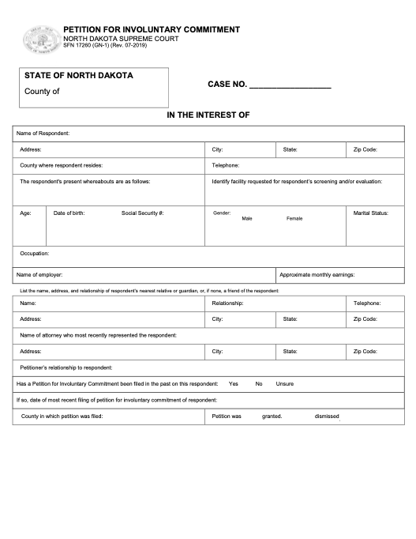
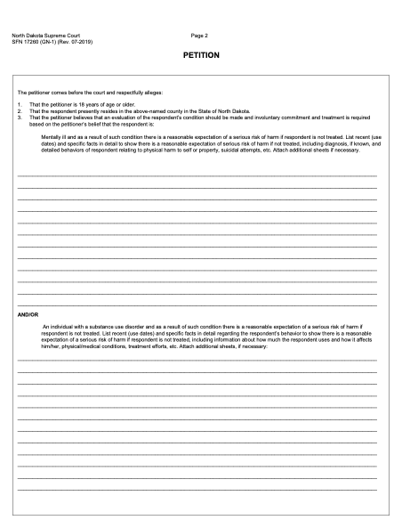

Slide 10
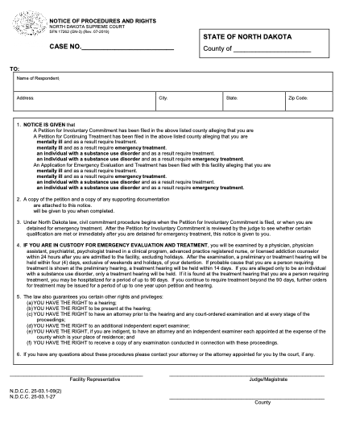
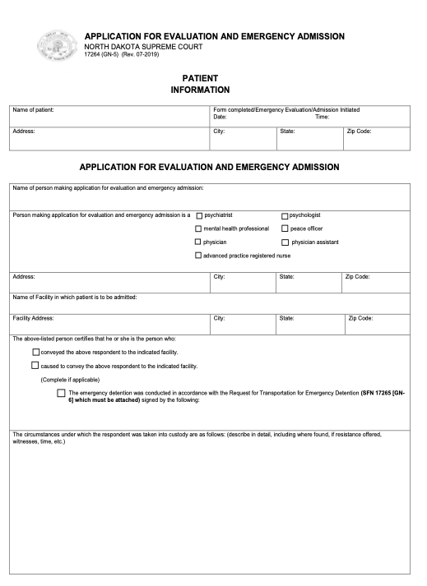

Slide 11
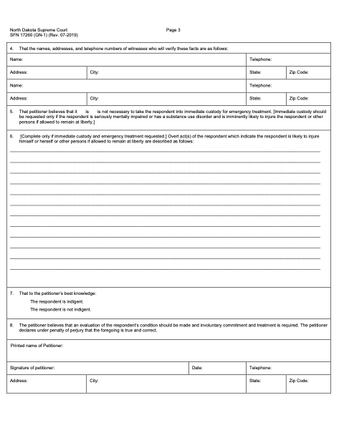
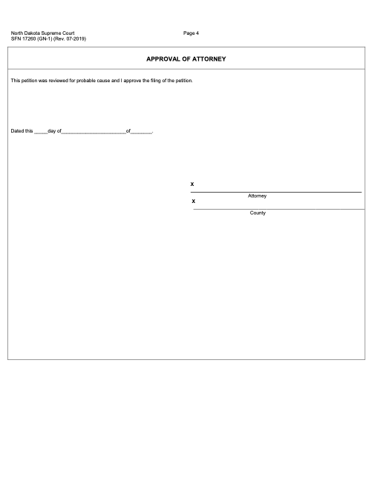

Slide 12
The Future of Civil Commitment Law
In a psychiatric emergency, the more you know about your own state’s laws and treatment options, the better prepared you will be to respond in the most effective way possible.

Slide 13
Criminal Diversion in North Dakota
% population served by a mental health court | % of population served by CTI | Combined average | Grade
22% | 34% | 28% | D
Criminal justice officials are responding to the criminalization of individuals with innovative programs designed to divert individuals with severe mental illnesses away from the criminal justice system.
(Treatment Advocacy Center, 2018)

Slide 14
Public Psychiatric Beds in North Dakota
Beds in 2016 | Beds in 2010 | Beds lost or gained | Beds per 100,000 people | Census of forensic patients | % of all beds occupied forensic | State ranking in beds per capita
140 | 150 | -10 | 18.5 | 65 | 46.4 | 3
(Treatment Advocacy Center, 2018)

Slide 15
Criminalization of Mental Illness in North Dakota
Like every state in the nation, North Dakota incarcerates more individuals with severe mental illness than it hospitalizes.
Total inmate population 2005 | Estimated population of SMI | Total psychiatric population in 2004 | Likelihood of incarceration vs. hospitalization
2,288 | 366 | 365 | 1.0 to 1
(Treatment Advocacy Center, 2018)

Slide 16
Consequences on Non-treatment
Increase of homeless individuals with serious mental health issues.
Increase of inmates with mental health illness in jails and prisons.
Increase percentage of individuals with schizophrenia or bipolar illnesses who attempt suicide during their lifetime.
Increase of suicide deaths.
Increase in homicides involving an offender with serious mental illness.
Increase of mass killings associated with serious mental illness.

Slide 17
Policy Change Recommendations
Stop the elimination of public psychiatric beds
Restore a sufficient number of beds to create access to inpatient care for qualifying individuals in crisis.
Make active use of the state’s civil commitment laws to provide more timely treatment for symptoms of psychiatric crisis and reduce the consequences of non-treatment on them, their families, and the community.

Slide 18
Recommendations
Persons with mental health conditions deserve the same degree of personal autonomy as other citizens with disabilities
Mental health treatment can only be effective when the patient embraces it
Should be used as last resort
Limit the need for involuntary treatment by increasing mental health services in ND
Limited options in ND (Behavioral Health Services, North Dakota 211, National Alliance on Mental Illness, ND medicaid)
Only 45.8% of adults with mental illness in ND receive any form of treatment
Remaining 54.2% with no mental health treatment
ND is ranked 42nd in providing access to mental health services
Addressing illness before it becomes crisis
Educate providers on assessing, addressing, and treating mental health disorders
Provide individuals tools to manage their mental health
Increased options and access to mental health services
(Gateway to Mental Health, n.d.)
Notes:
Persons with mental health conditions deserve the same degree of personal autonomy as other citizens with disabilities -
Mental health treatment can only be effective when the patient embraces it… for this reason it should be used as a last resort
Should be used as last resort
We can limit the need for involuntary treatment, in my opinion, if we increase mental health services addressing illness before it becomes crisis
Only 45.8% of adults with mental illness in ND receive any form of treatment
Remaining 54.2% with no mental health treatment
ND is ranked 8 out of 50 for providing lack of access to mental health services -- this needs to change
We need to increase access-- our recommendations are
Educated professionals how to identify mental health disorders, initial treatment plans, schedule follow-up appointments
Provide patients with tools - stress reduction, coping with depression/anxiety, medication compliance
Increase access to mental health services
Limited options in ND
Behavioral Health Services
ND medicaid
North Dakota 211
National Alliance on Mental Illness
Establish more outpatient clinics crisis centers
Expand inpatient psychiatric beds sizes
telephone hotlines,
addiction programs
Increased beds for partial hospitalization programs

Slide 19
References
Gateway to Mental Health Services. (n.d.). Mental Health Resources in North Dakota. rtor.org. https://www.rtor.org/directory/mental-health-north-dakota/
Hedman, L. C., Petrila, J., Fisher, W. H., Swanson, J. W., Dingman, D. A., & Burris, S. (2016). State laws on emergency holds for mental health stabilization. Psychiatric Services, 67(5), 529–535. https://doi.org/10.1176/appi.ps.201500205
North Dakota Century Code Title 25. (n.d.). Chapter 25-03.1 [PDF]. North Dakota Legislative Branch.
https://www.legis.nd.gov/cencode/t25c03-1.pdf
State of North Dakota Courts. (n.d.). Mental Health Commitment Forms.
https://www.ndcourts.gov/legal-self-help/mental-health-commitment/forms

Slide 20
References Continued
Substance Abuse and Mental Health Services Administration: Civil Commitment and the Mental Health Care Continuum. (2019). Historical Trends and Principles for Law and Practice. https://www.samhsa.gov/sites/default/files/civil-commitment-continuum-of-care.pdf
Treatment Advocacy Center. (2018). Eliminating Barriers to the Treatment of Mental Illness.
https://www.treatmentadvocacycenter.org/browse-by-state/north-dakota

